Slide 1
Techman Robot Inc.
Tommy.Chien | may. 2019

Slide 2
TMvision Typesetting

Slide 3
Introduction
Purpose
1.Visual module text display position and size adjustable
2.OCR, Number OCR support text display parameters are adjustable
3.Modify how Gauge content is displayed
Equipment
TM all series
Function operation

Slide 4
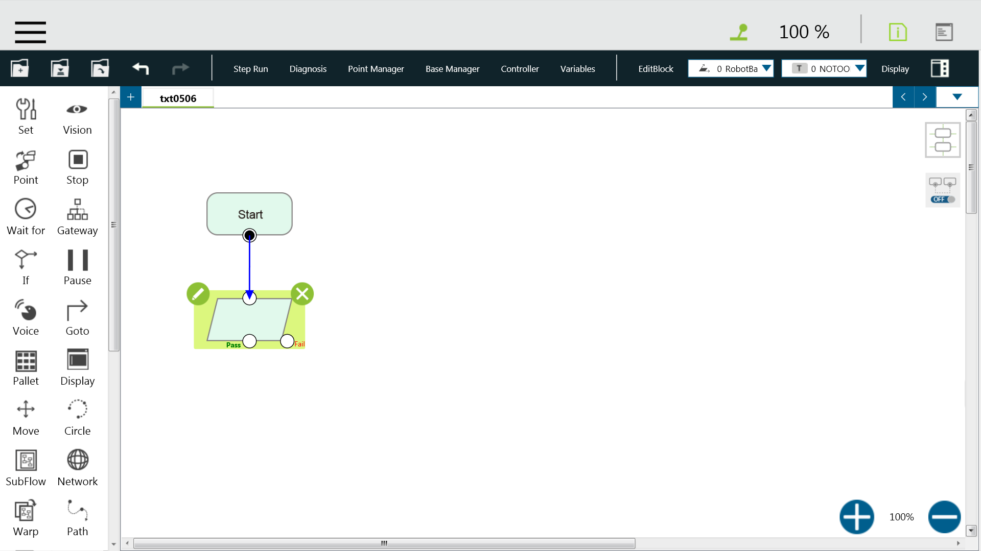
Function operation(1/10)

Slide 5
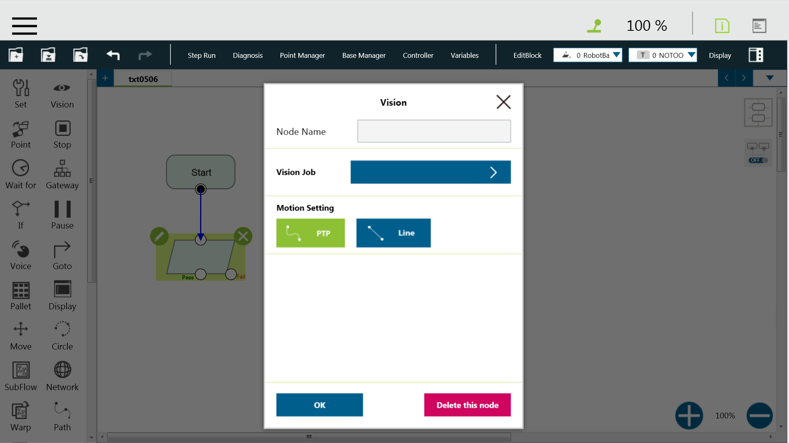
Function operation(2/10)

Slide 6
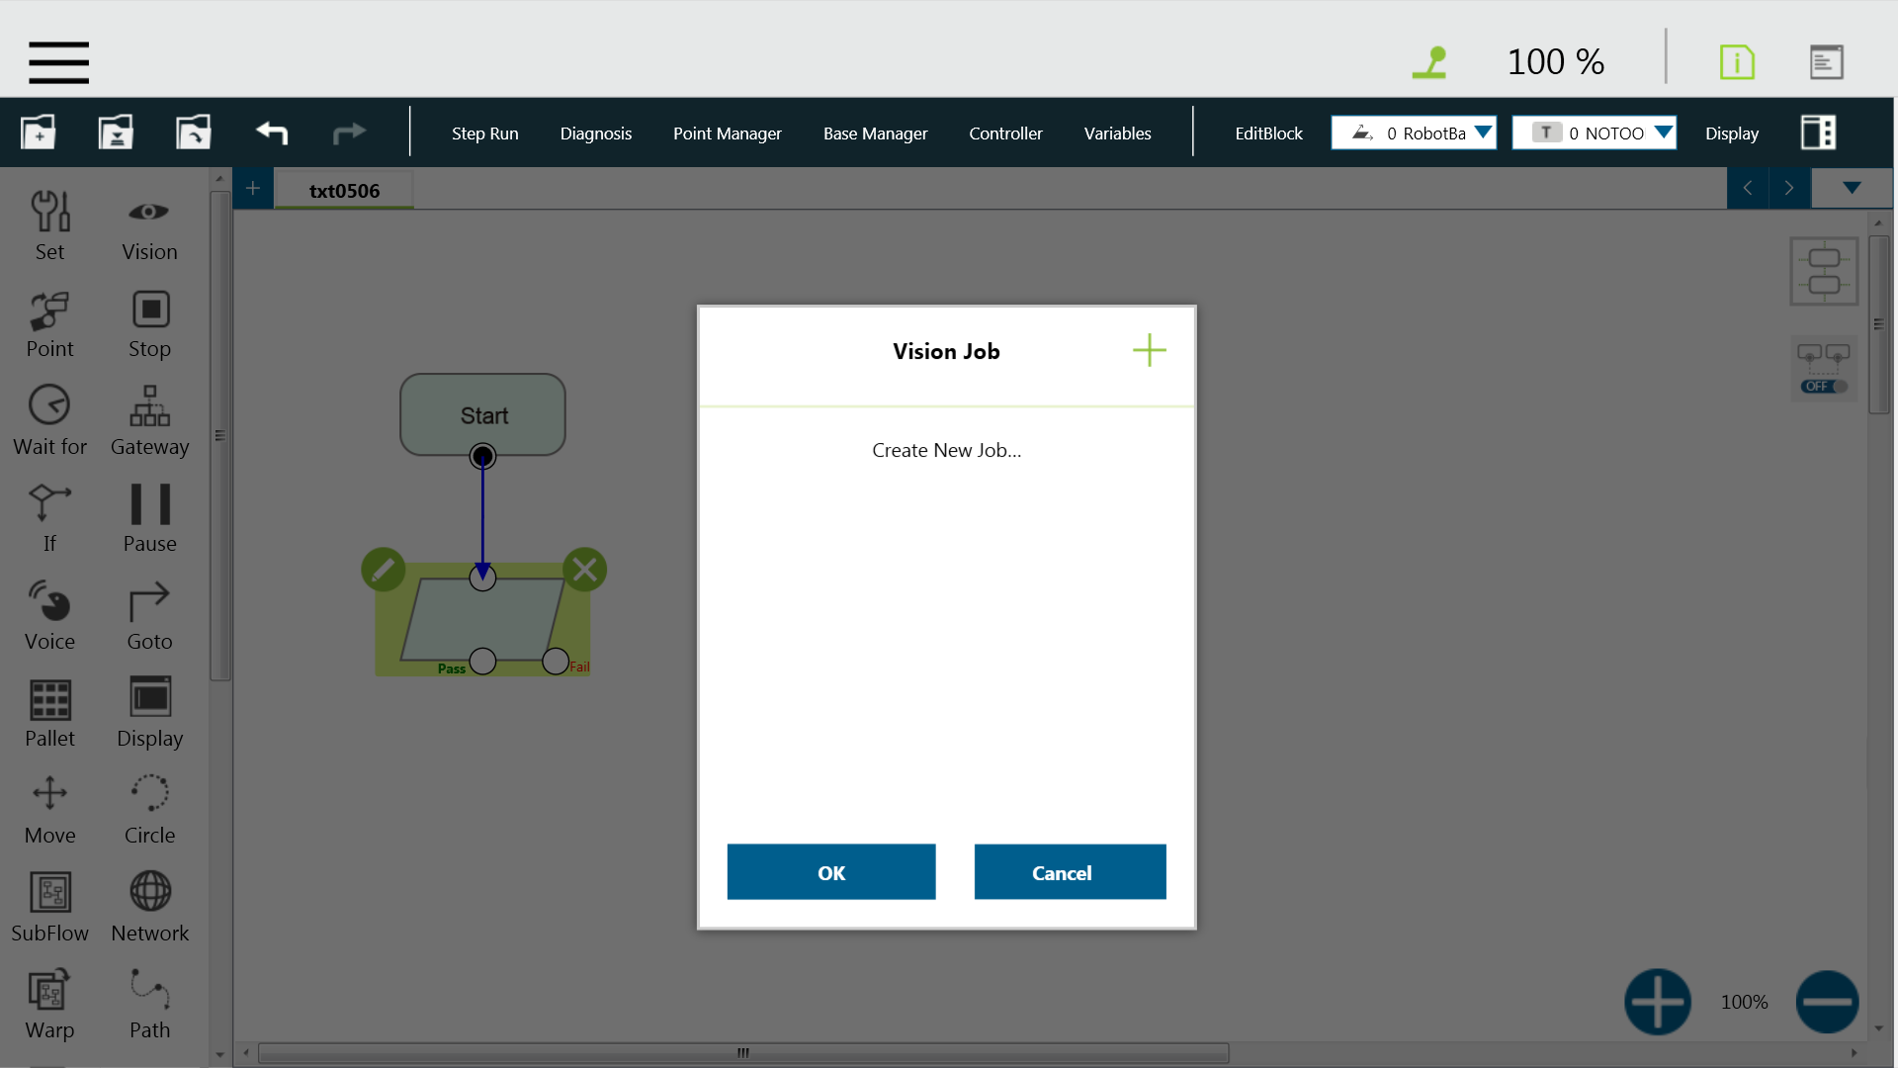
Function operation(3/10)

Slide 7
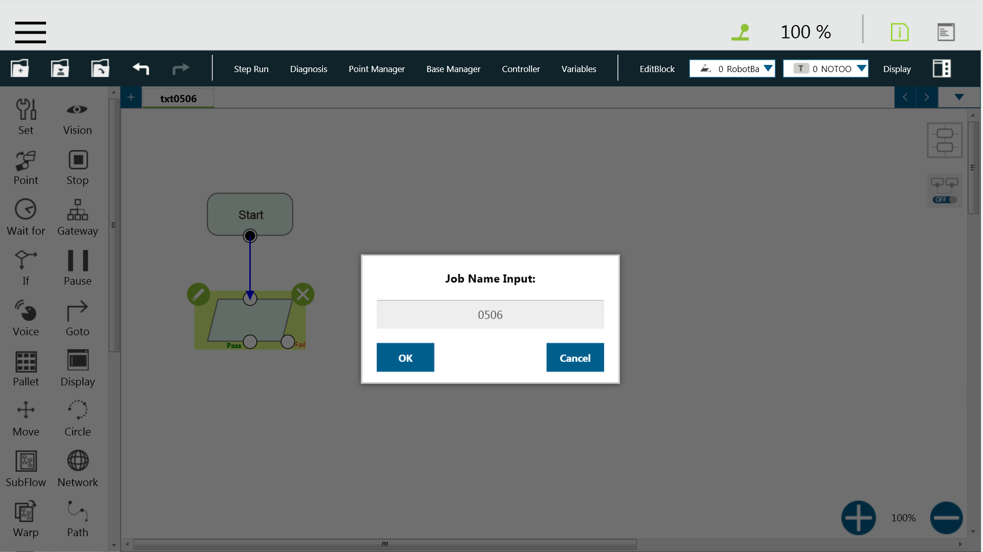
Function operation (4/10)

Slide 8
Function operation (5/10)

Slide 9
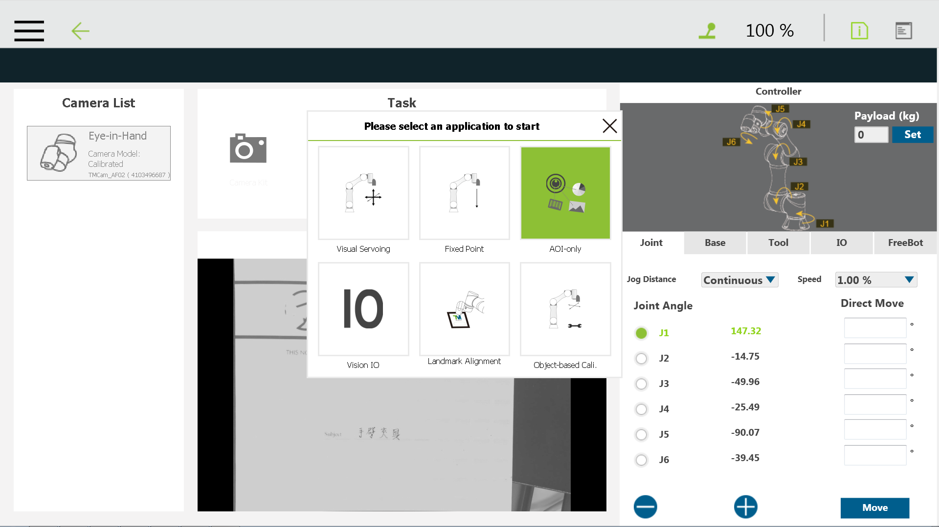
Function operation (6/10)

Slide 10
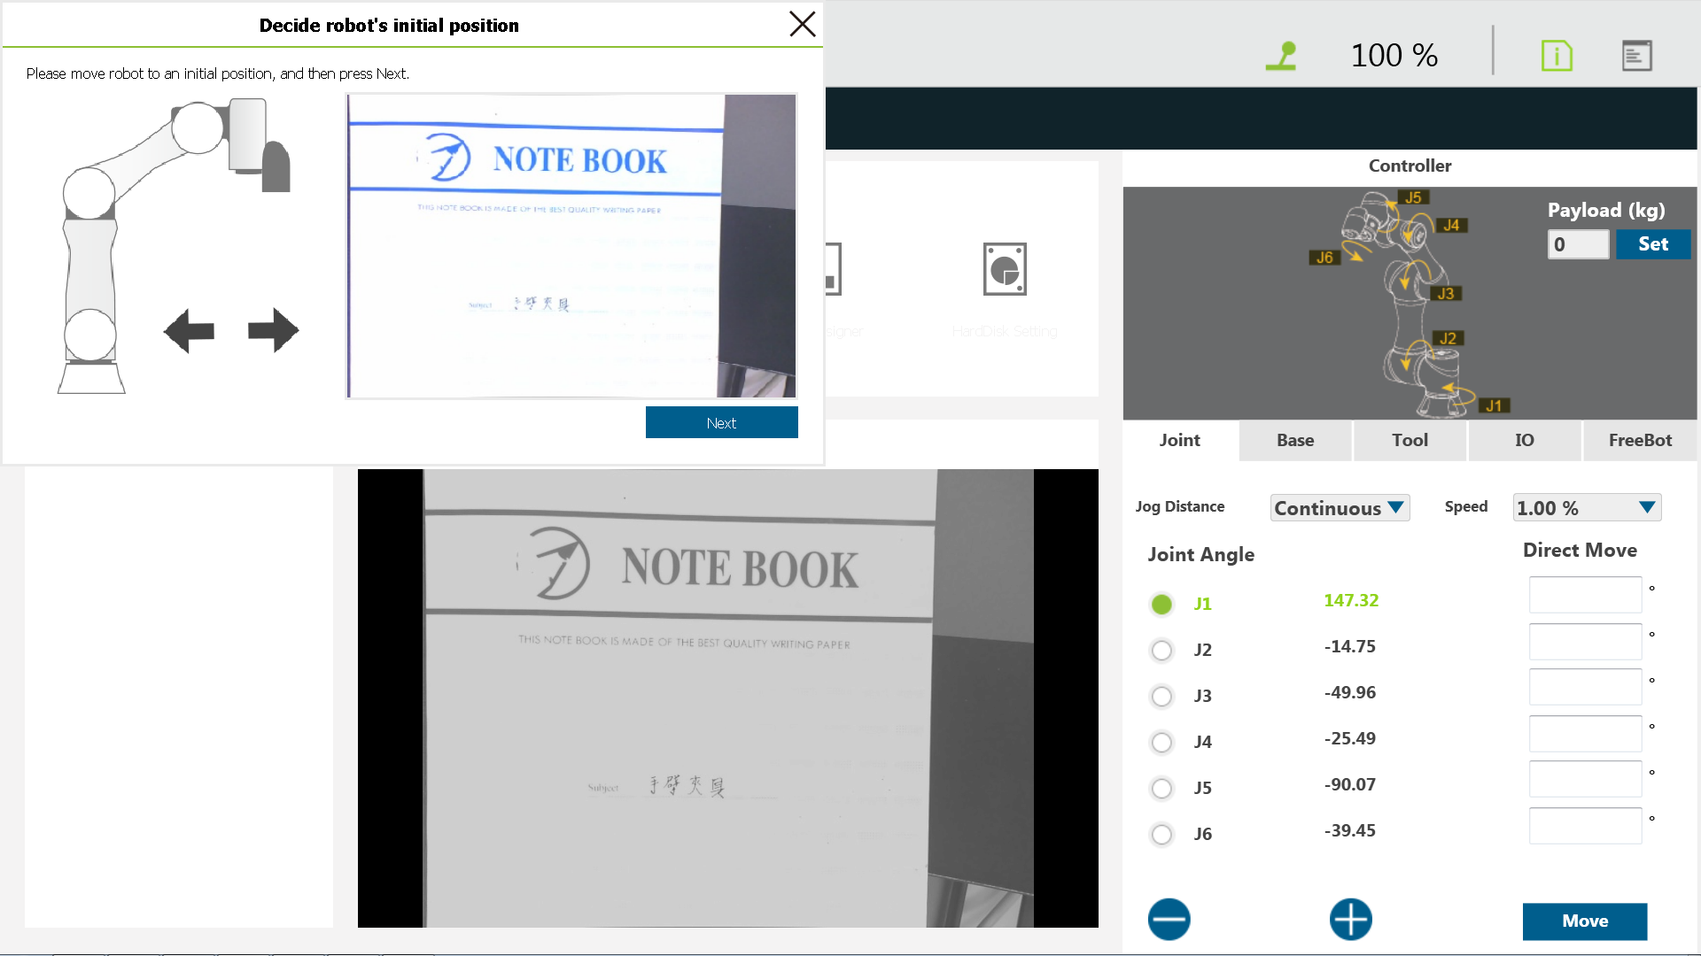
Function operation (7/10)

Slide 11
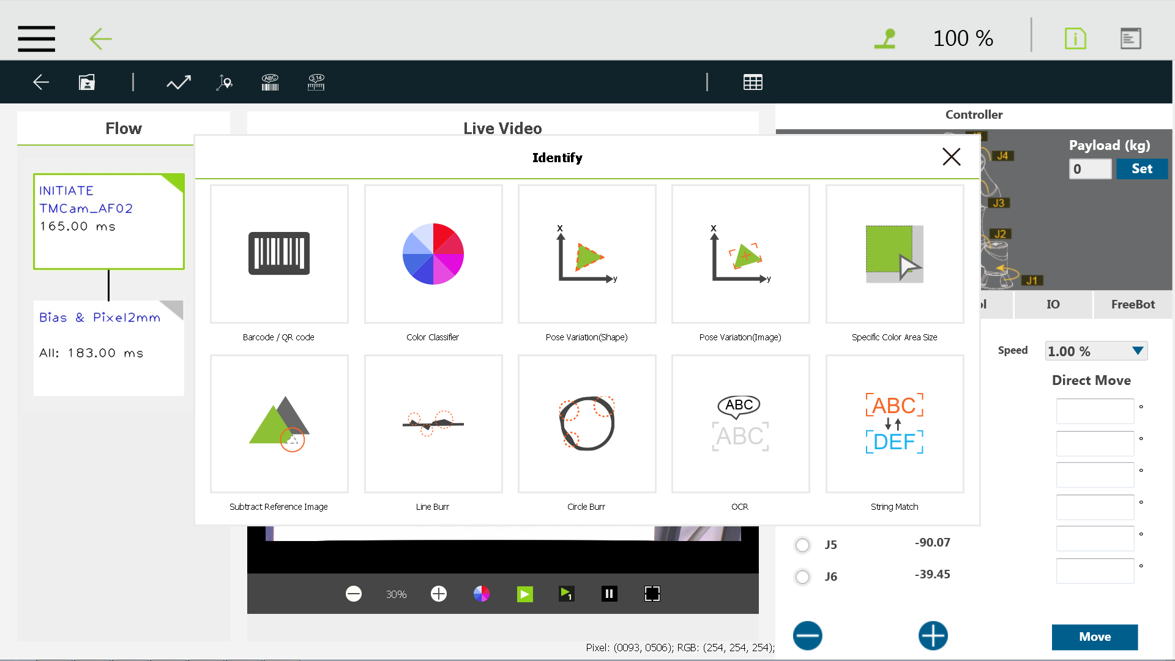
Function operation (8/10)

Slide 12
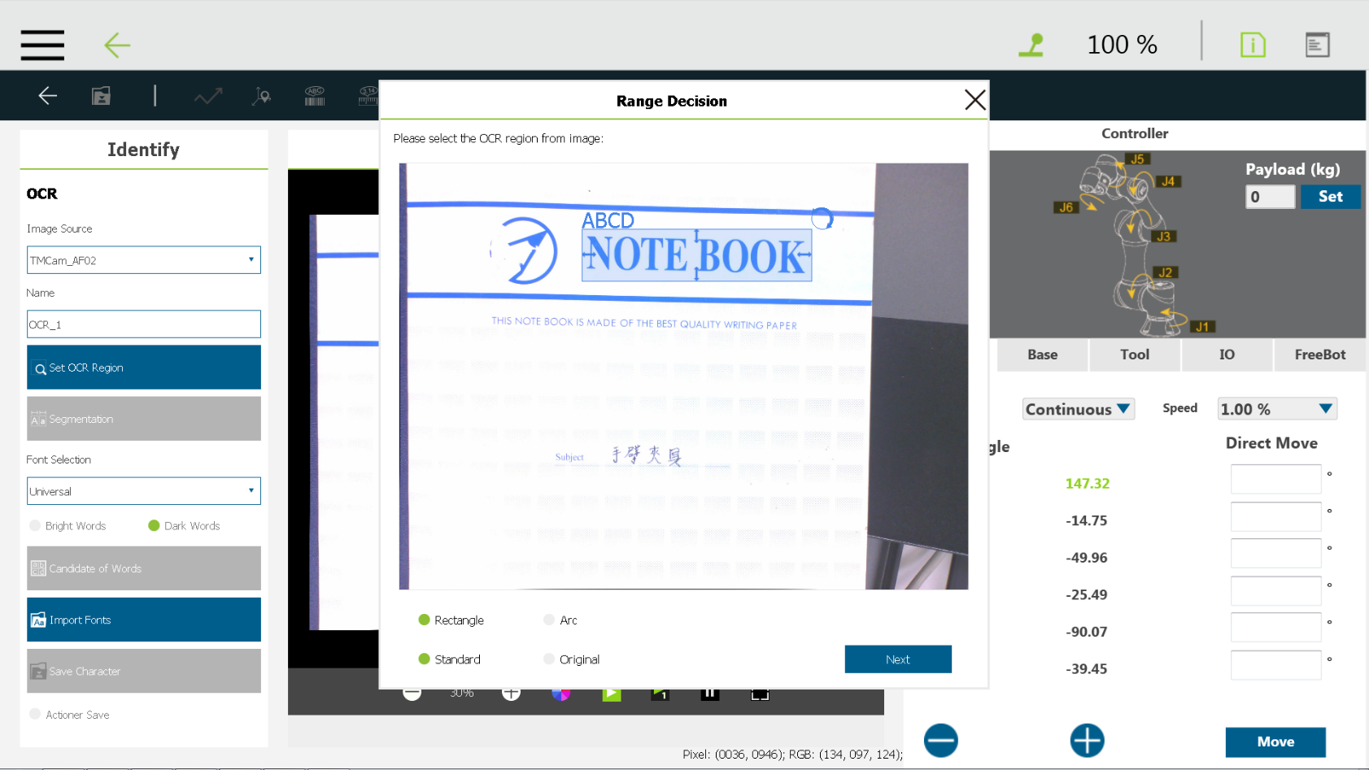
Function operation (9/10)

Slide 13
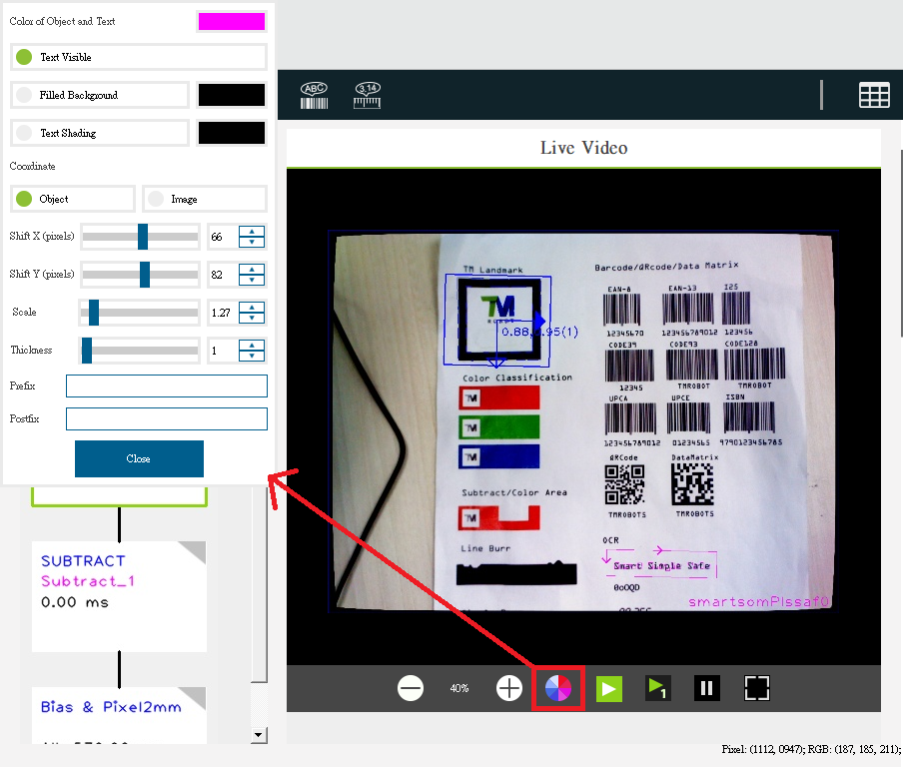
Function operation (10/10)
Location and size of text are adjustable.
OCR and number OCR support adjustable parameters for text display.
Refined display of gauge content.

