Slide 1
Techman Robot Inc.
Hsiang Tsui 2019.05.02

Slide 2
[Import/Export] Add Apply to All Files

Slide 3
Introduction
Purpose
Add "Apply to all" option when import/export projects with duplicated name
Equipment
TM all series
Function operation

Slide 4
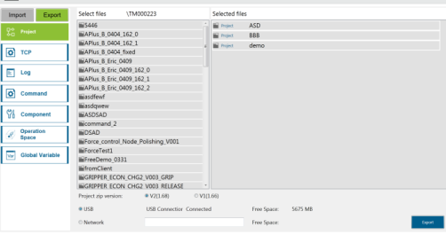
Operation Flow
Previously
Duplicated file names are processed one by one.
Now
Duplicated file names are listed all at once.
Users are able to choose from overwriting to all when selecting “Yes” or “Cancel”
Users can rename the projects when users select “No”
Warming
There are 3 folders name existed.
1
ASD Folder name existed.
YES: Overwrite.
NO: Save as.
CANCEL: Ignore
Duplicated folder names.
Apply to all folders
There are 3 Folder name existed.
Yes
No
Cancel
2
4

