Slide 1
Force Control
A leading company in collaborative robot and vision technologies.
Confidential

Slide 2
Gravity Compensation

Slide 3
Purpose:
Dynamic compensation:
In the process of rapid movement, the inertial moment(force) is generated, so the system must execute the “dynamic compensation” process to avoid misjudgment caused by inertial force (moment).
Static compensation:
Static compensation can be performed by statically detecting the mass center and weight of an object using a six-axis force gauge.
Connecting tool
Force Sensor
Grippers

Slide 4
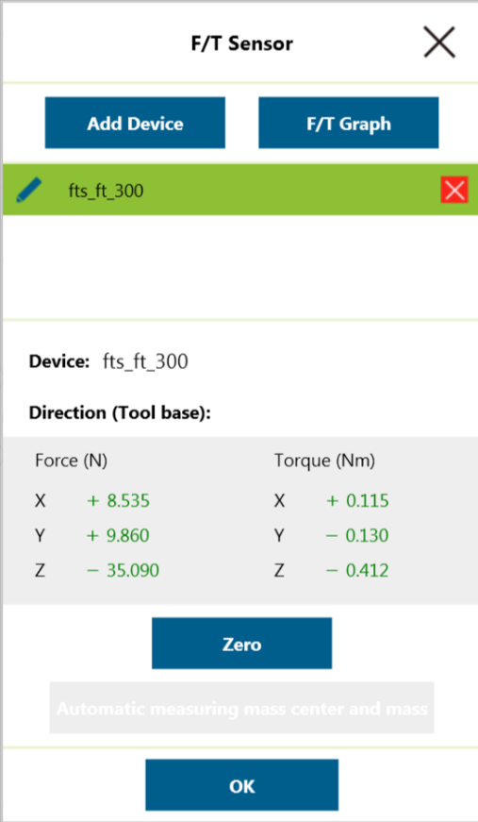
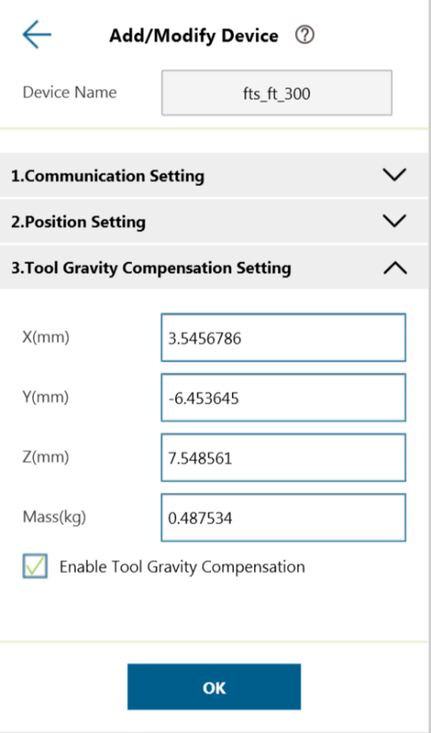
User can define the position of the mass center
Need to enable the “Gravity Compensation”

Slide 5
Force Sensor Setting

Slide 6
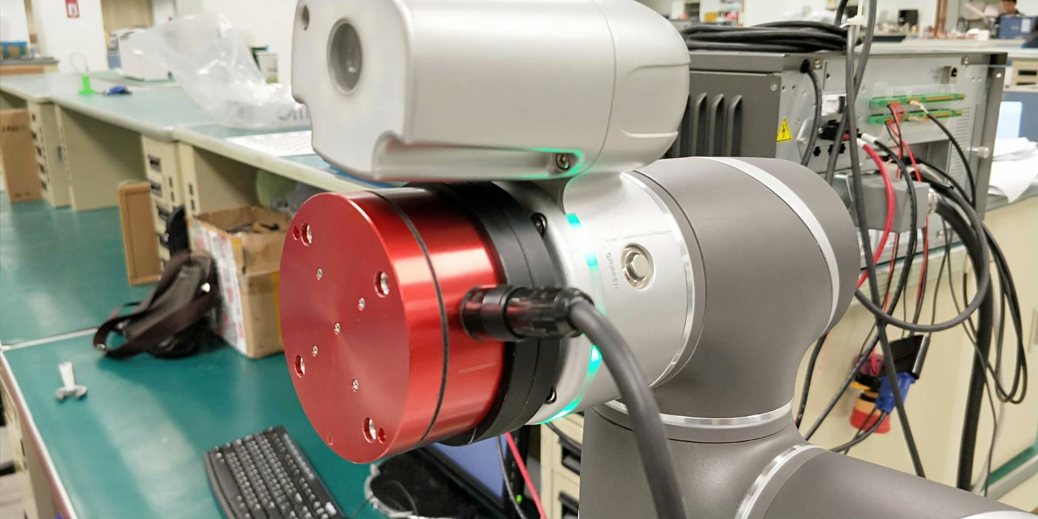
STEP 2
STEP 1

Slide 7
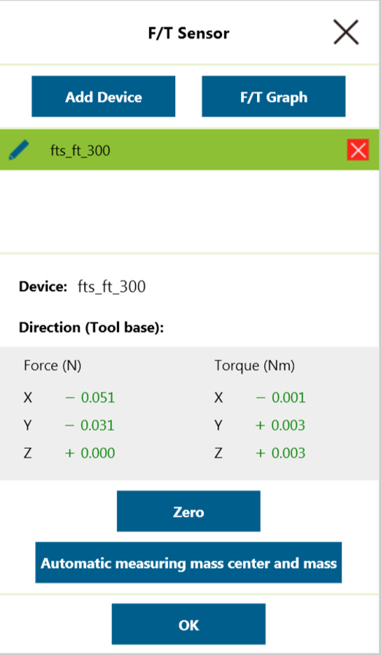
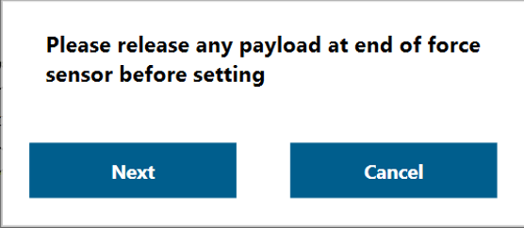
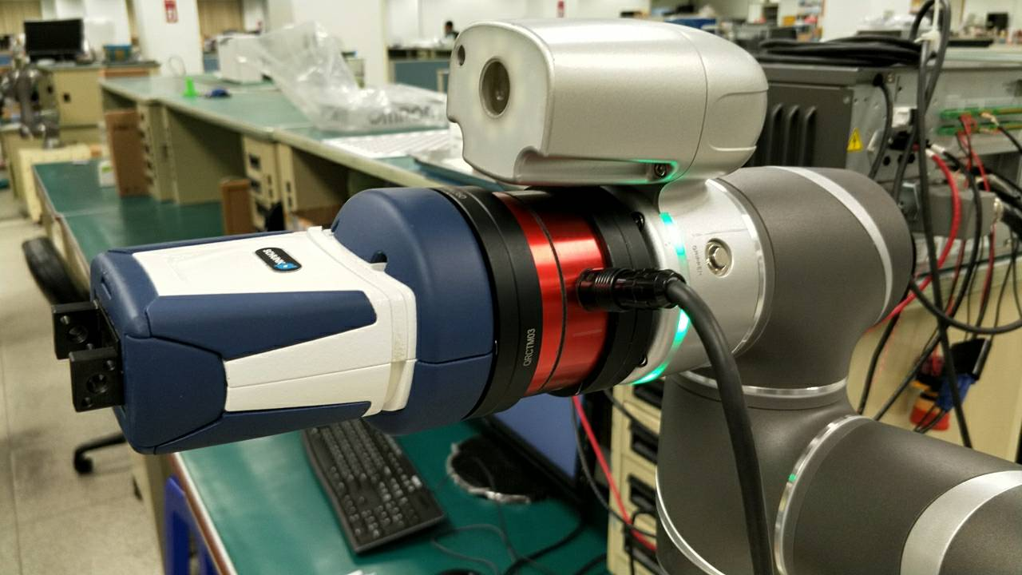
STEP 4
STEP 3

Slide 8
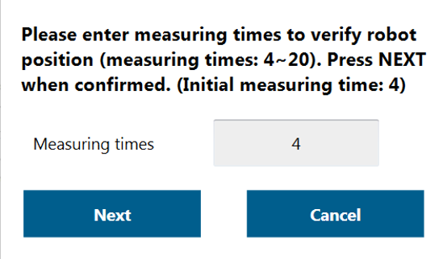
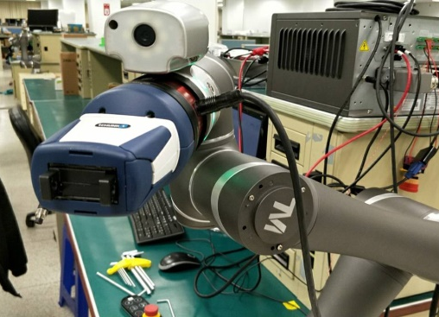
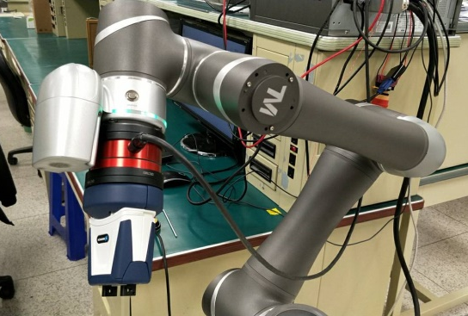
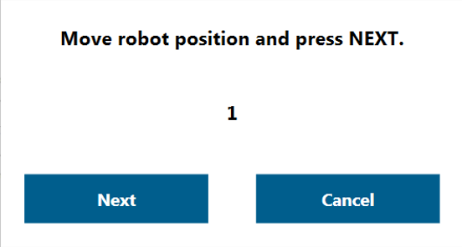
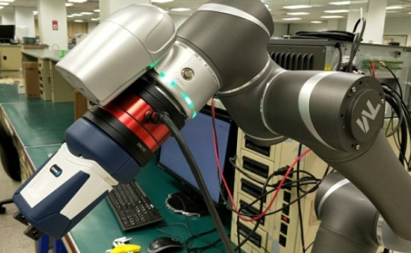
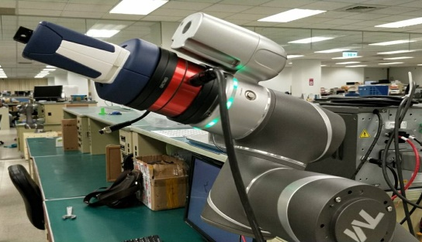
STEP 5
STEP 6
Attention: Use as much different position for system calculating more precisely.

Slide 9
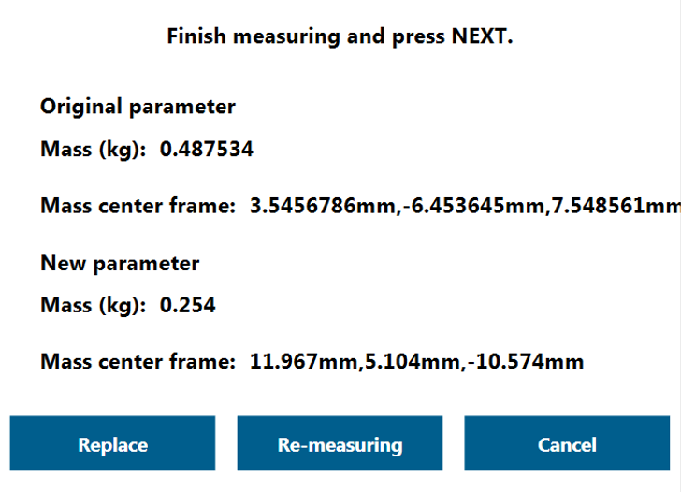
Step 7
Use the current value(position) as the tool mass center.
Redo the calculating process
Dismiss the current value

Slide 10
Force Control Node

Slide 11
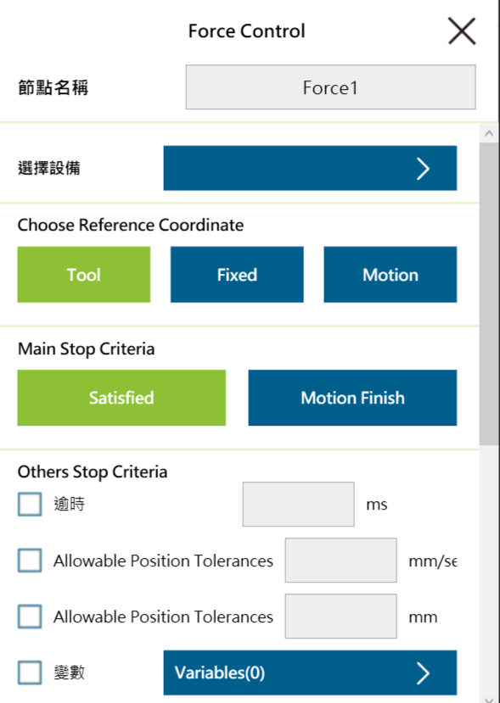
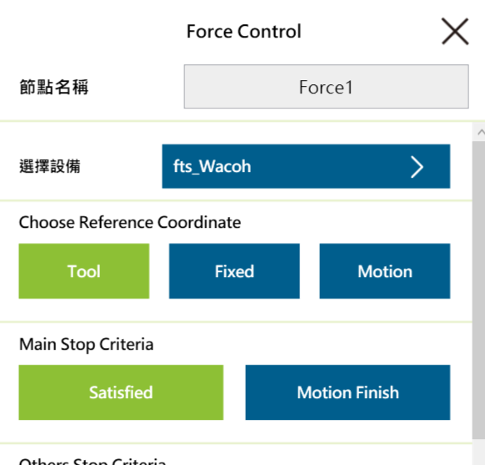

Slide 12
Reference Coordinate: Tool Base
Tool Base (Default)
The force sensor calculates that the resulting coordinate system coincides with the direction of the TCP coordinate system.
X
X
Z
X
Z
X
Z
Z

Slide 13
Reference Coordinate: Fixed Base
Fixed
n
n
Landmark
Landmark
Record the current TCP Pose, and then force that be measured is based on this Base.
This Pose can be selected to record on another base (Record on another base).

Slide 14
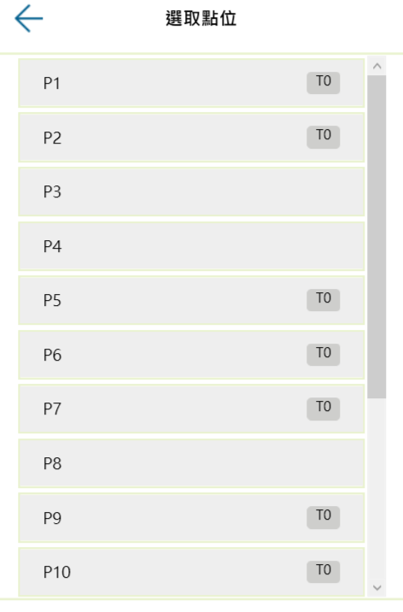
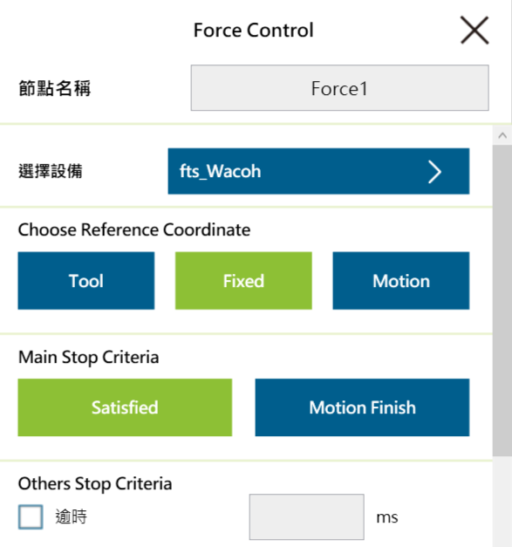

Slide 15
Reference Coordinate: Motion
TM
Move Direction ($\vec{M.D.}$)
$$Force=\vec{X}(Default force direction)$$
Tool-Z
The coordinate sensed by the force changes with the path (speed tangent direction).

Slide 16
Force control only
Y
X
Z

Slide 17
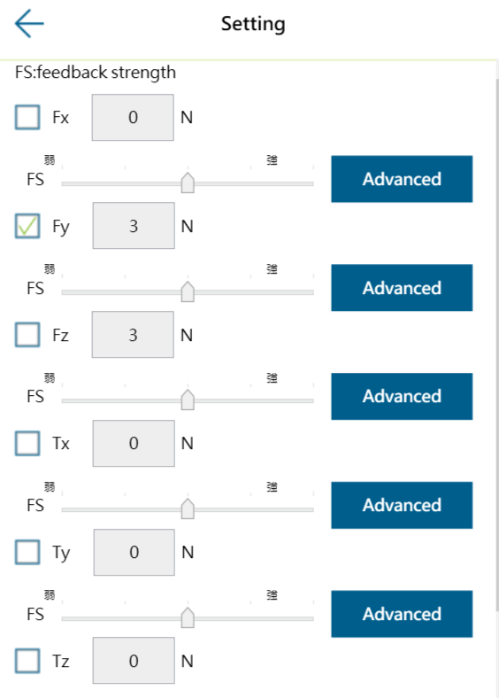
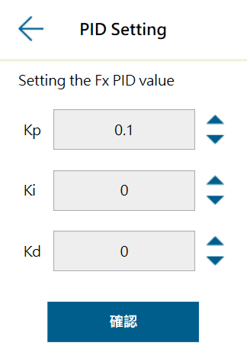
PID could be modified here

Slide 18
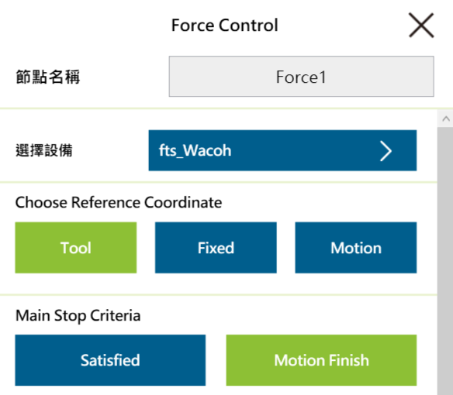
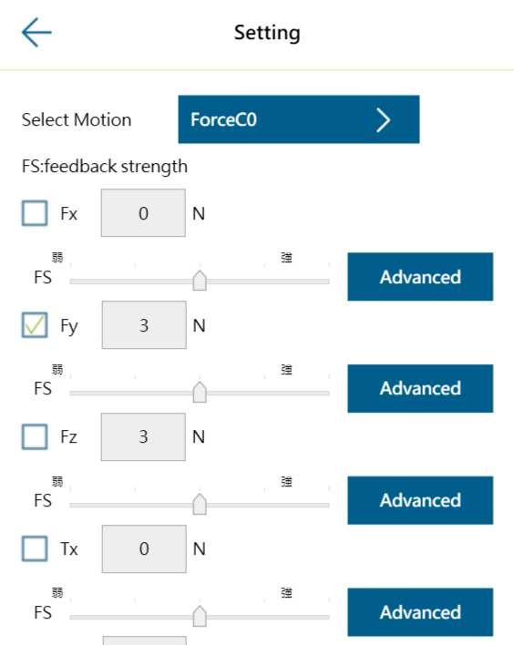
After selecting the “Motion Finish” function, the Subflow for Force control will be generated.

Slide 19
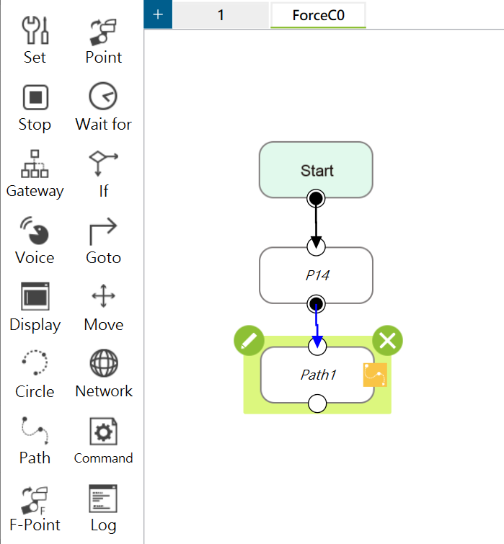
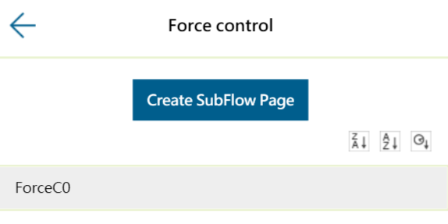
The subflow is for the Force control node only. It will generated the path according to the Force that detected.

Slide 20
