Slide 1
Techman Robot Inc.
Aaron 2019/05/16

Slide 2
Create a independent TCP speed limit for hand guide mode

Slide 3
Outline
Purpose
Add independent TCP speed setting for hand-guiding mode.
User can setting it according to safety or efficiency concern.
Equipment
TM5 / TM12 /TM14
Function operation
Setting→ Safety setting Page

Slide 4
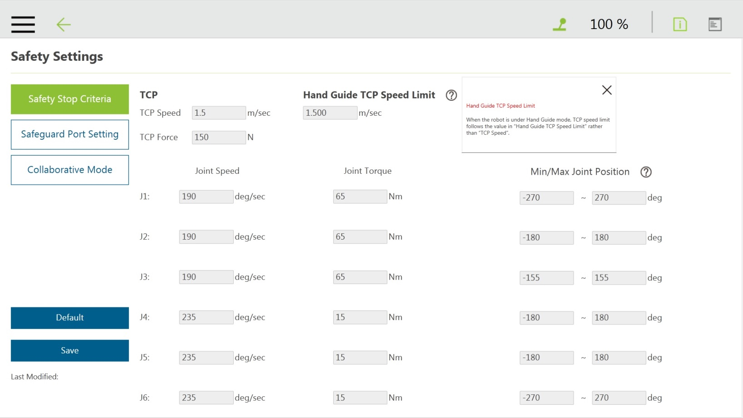
Function Operation

Slide 5
