Slide 1
Techman Robot Inc.
Aaron 2019/05/16

Slide 2
Use 3 vision-bases fusion to define a orientation-correct base.
Aaron Lin | 20190506

Slide 3
Outline
Purpose
Build a new base from vision with minimum orientation error.
This function is designed for saving the working plane of large workpiece
with big plane surface.
Equipment
TM5 / TM12 / TM14
Function operation
Use 3 vision bases to define a orientation-correct base.
Since the vision base might introduce some orientation error and the error will become critical if the working piece is large.
In order to define the accurate base, user can define a working plane (base) with 3 vision bases to eliminate the variance.

Slide 4
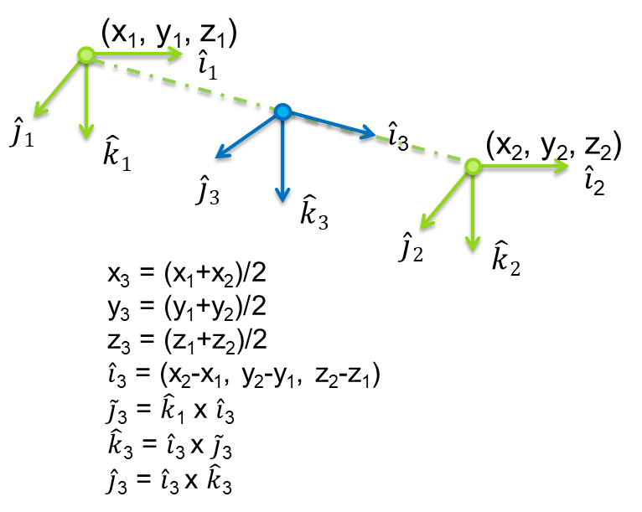
Existing / New
Existing:
base from 2 vision-bases
New:
base from 3 vision-bases
Form a new coordination between the link of 2 existing bases.
1. Set the origin of 1st base as new origin
2. Set the vector from base_1 to base_2 as new x axis.
3. Define the new Z axis that vertical to new x axis and vector for base_1 to base_3.
→ Get the new base.

Slide 5
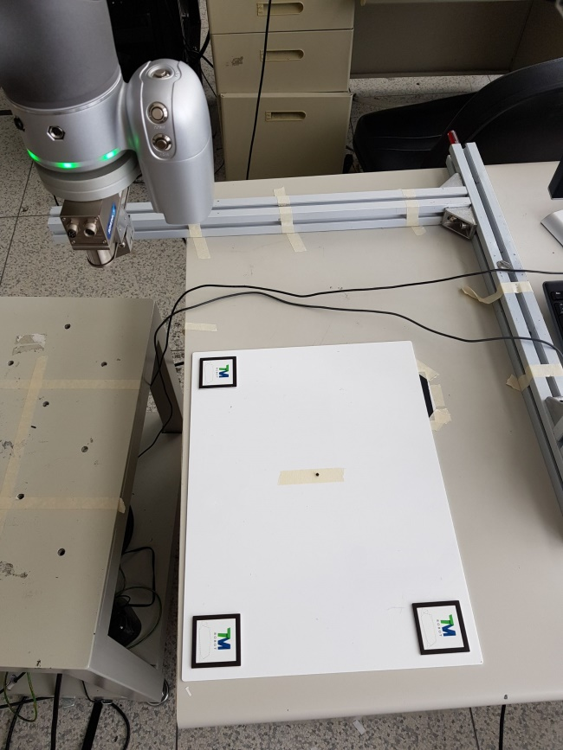
Step 1. Put 3 Landmarks on your workpiece.
Put 3 Landmarks on your workpiece.
It’s recommended to put them at the corners of the working plane for measure the maximum area.
※ Notice:
3 landmarks should put on the same plane.
Put the landmark on it with same orientation (same r_{x}, r_{y}, r_{z}). Otherwise, it could increase error and inaccuracy.
Vision Base _1
Vision Base _2
Vision Base _3

Slide 6
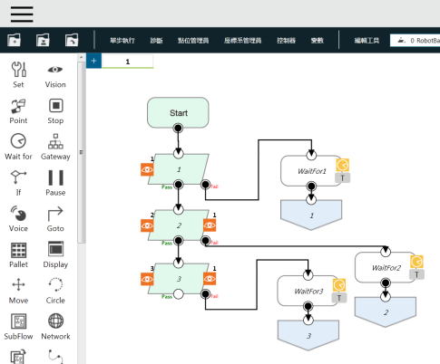
Step 2. Build 3 vision base.
Use 3 “Vision Node” to build 3 vision base.
1.
Vision Base _1
2.
3.
Vision Base _2
Vision Base _3

Slide 7
Step 2. Build 3 vision base.
※ Step 2. Notice:
3 landmarks should put on the same plane.
Put the landmark on it with same orientation (same rx, ry, rz). Otherwise, it could increase error and inaccuracy.
1.
2.
3.

Slide 8
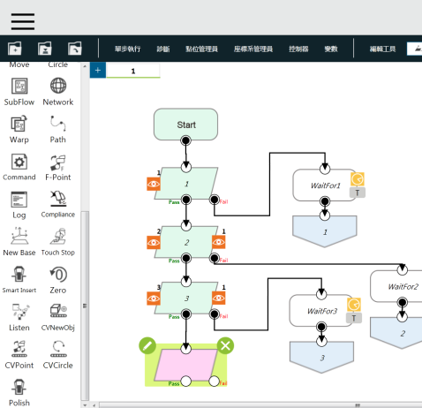
Step 3. Add a ‘New Base Node’
Add a “New Base” in the workflow.

Slide 9
Step 3-1. Create a new base with bases.

Slide 10
Step 3-2. Choose “Three Vision Base”

Slide 11
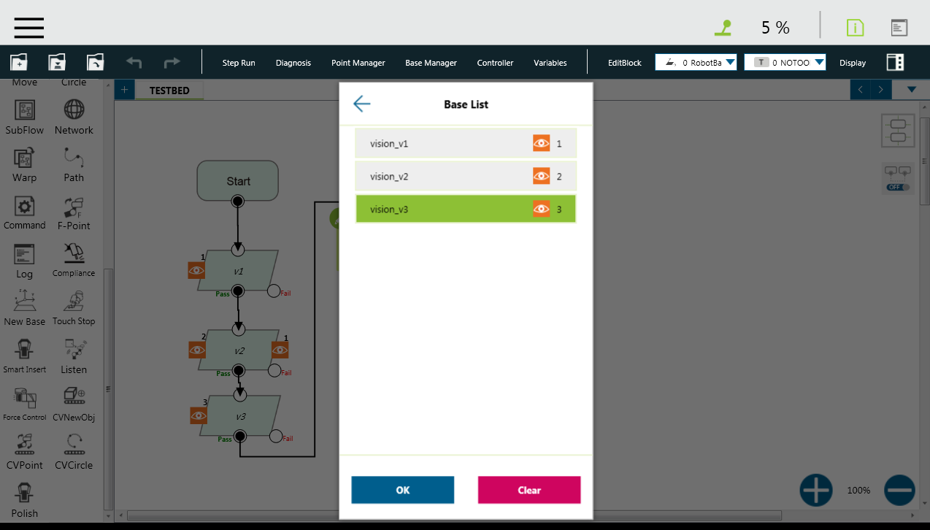
Step 3-3. Link 3 bases one by one.
Link the bases one by one.

Slide 12
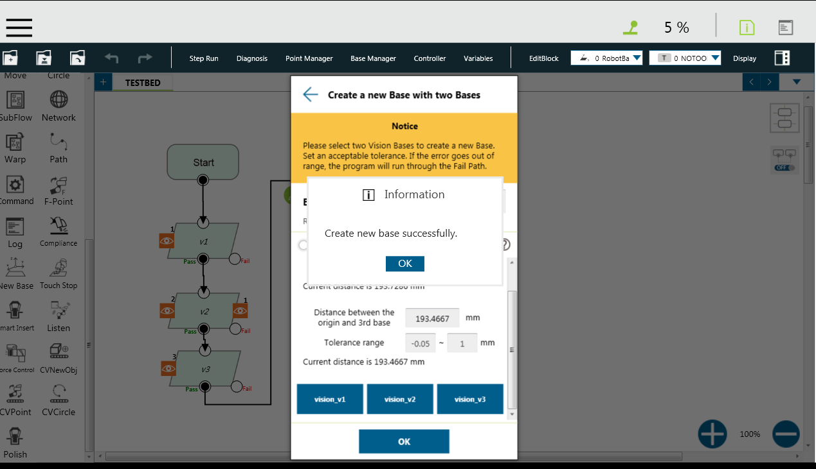
Step 3-4. Create the new Base.
Pop out the result.

Slide 13
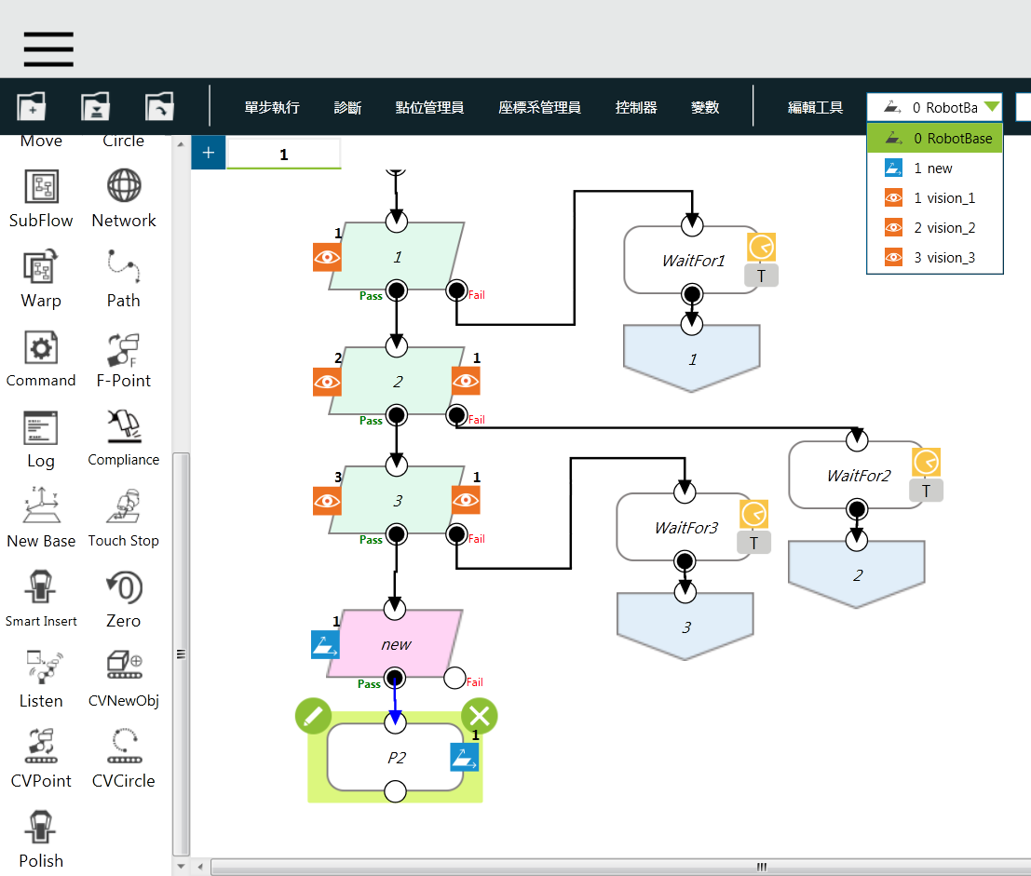
Step 4. Use the new base as reference in workflow.
The new base will be show on the base list.
User can use it as reference in following node (example: P2).
1.
2.

Slide 14
Notice
If there are several contacts with the workpiece which is based on the new created base, make sure the gripper, sucker, or arm would not push the workpiece or make it move it position after locate the work plane by vision fusion. User can modify the contact gesture and approaching speed to avoiding such variance.

