Slide 1
Techman Robot Inc.
Aaron 2019/05/16

Slide 2
[Vision node]Visual Servoing disable Identify and Measure functions

Slide 3
Outline
Purpose
Disable these function (“Identify” and “Measure”) to avoiding confusion when using “Visual Servoing”.
Equipment
TM5 / TM12 /TM14
Function operation

Slide 4
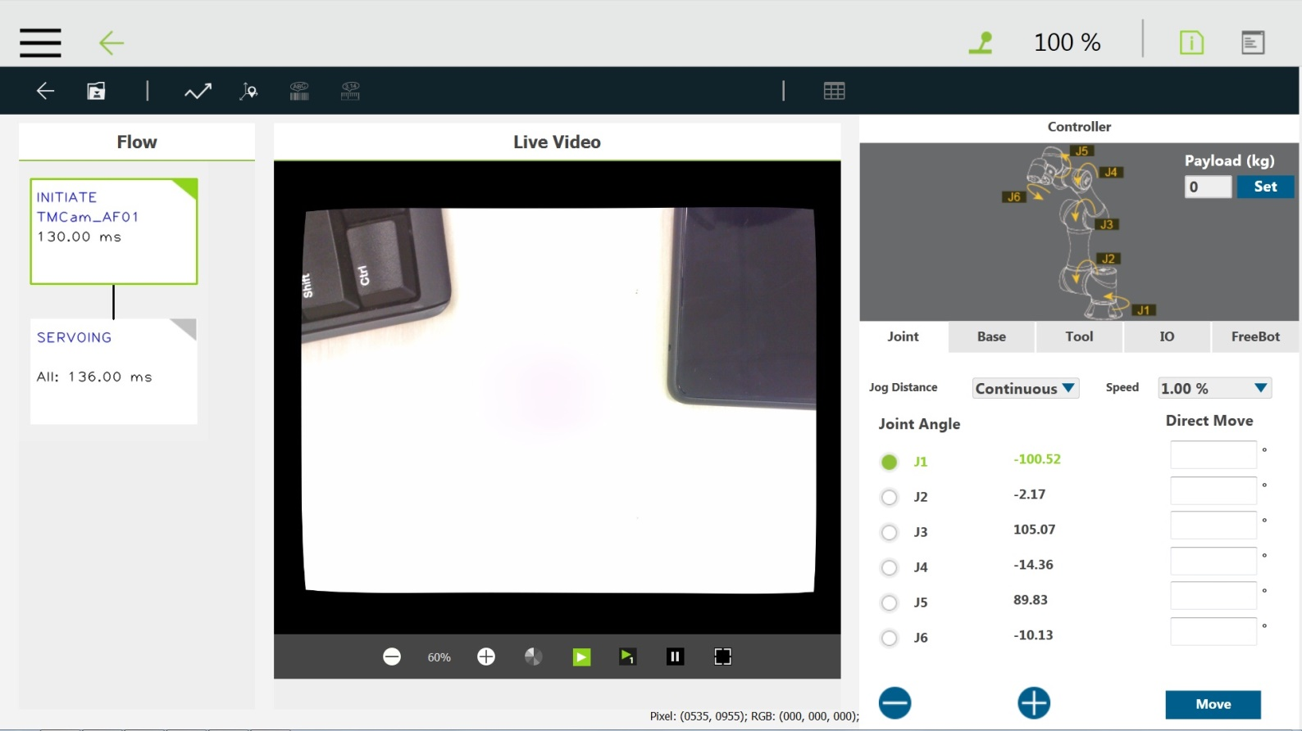
Function Operation
Disabled button

Slide 5
