Slide 1
Techman Robot Inc.
Hsiang Tsui 2019.05.02

Slide 2
Project Open Menu
to Add Project Information and Batch Delete

Slide 3
Introduction
Purpose
Project information and delete function are added in "open old project" page
Equipment
TM all series
Function operation

Slide 4
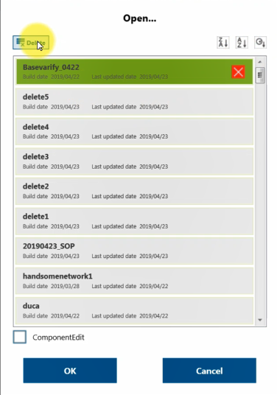
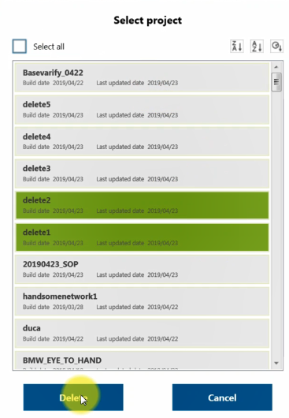
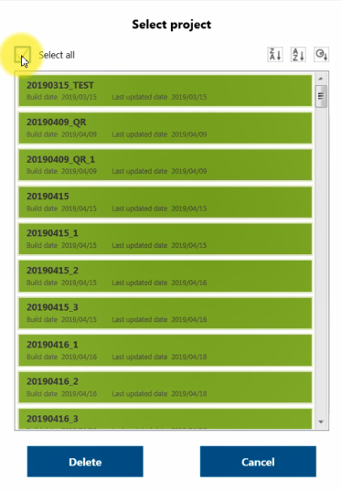
Function Operation
Users are able to delete single, multiple, or all projects at a time.
OR
Select Delete for choosing delete all projects or multiple projects
Select projects that users want to delete; Multiple projects are enable
Click “Select all”to delete all projects
4

Slide 5
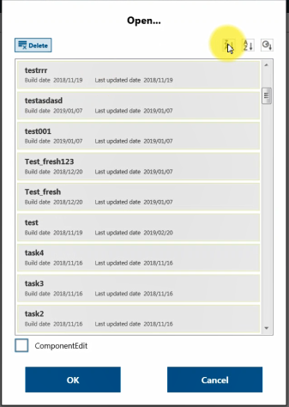
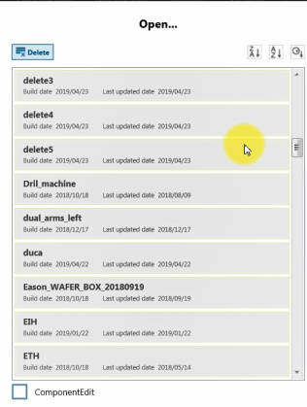
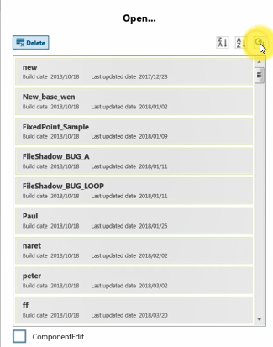
Projects are listed with the built date and the modified date.
Users are able to sort projects alphabetically or chronologically with buttons.
Select Z to A button to set the projects order from Z to A decided by the title of the projects
Select A to Z button to set the projects order from A to Z decided by the title of the projects
Select Time button to set the projects order decided by the editing time of the projects
5

