Slide 1
Techman Robot Inc.
Shaun.Chang 2019.05.14

Slide 2
Payload supports variables

Slide 3
Outlook
Purpose
Payload supports variables
Equipment
TM all series
Function Operation

Slide 4
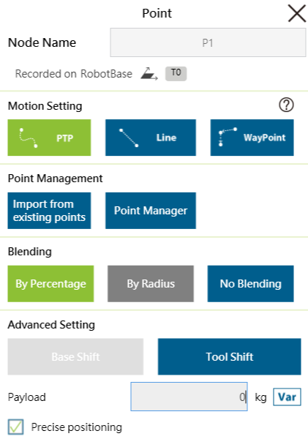
Function Operation
Payload supports variables can be selected at point node.

