Slide 1
Techman Robot Inc.
Hsiang Tsui 2019.05.02

Slide 2
[Expression Editor] Adjustable equation order between columns

Slide 3
Introduction
Purpose
Adjustable equation order between columns
Equipment
TM all series
Function operation

Slide 4
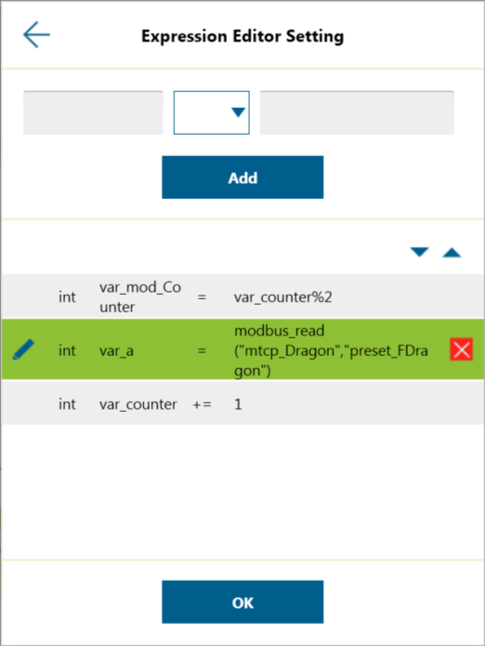
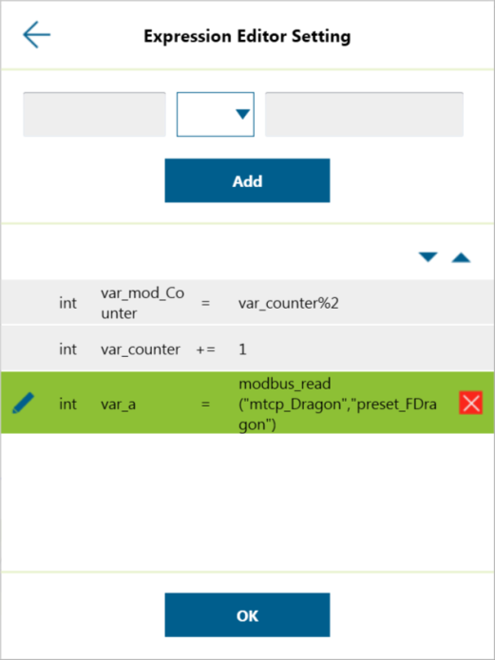
Previously
The order of equations is fixed.
Now
The order of equations is adjustable.
1. Select the target equation
2. Use the triangle to adjust
the order up or down.
4

