Slide 1
Techman Robot Inc.
Hsiang Tsui 2019.05.02

Slide 2
[Modbus] Add TCP Force and Safety Related Parameters

Slide 3
Introduction
Purpose
Add TCP force and safety related parameters in Modbus list (read only)
Equipment
TM all series
Function operation

Slide 4
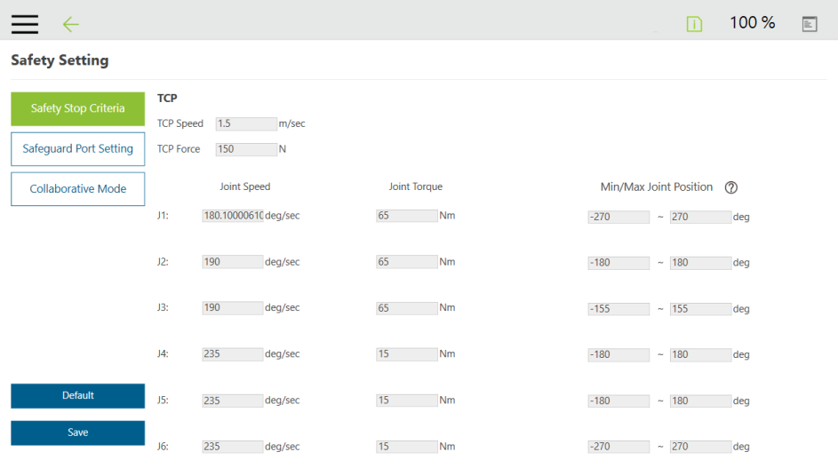
Standard
軟體版本
1.72
Modbus - code table
Safety Stop Criteria
TCP Force
4

