Slide 1
Techman Robot Inc.
Steven Yueh 2019.04.22

Slide 2
Define Typical Speed

Slide 3
Introduction
Purpose
Speed (%) is renamed to Percentage of Typical Speed.
Equipment
TM all series
Function operation

Slide 4
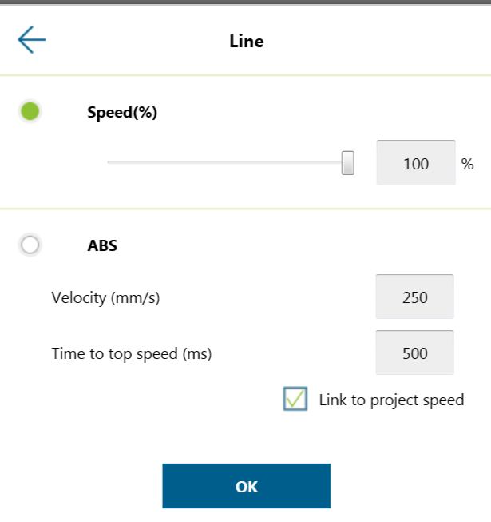
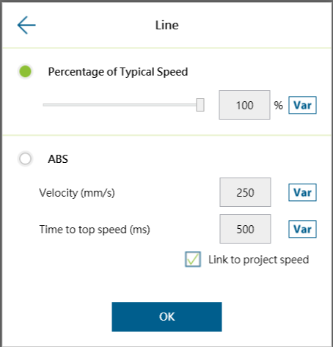
Before and After
Available range of ABS velocity broadens from 0 to 4500 mm/s.
Available ABS time to top speed broadens from 1500 to 9999 ms.

