Slide 1
TECHMAN ROBOT
A leading company in collaborative robot and vision technologies.

Slide 2
Add UI languages (TRI)

Slide 3
Outline
Purpose
Add 7 more European languages for HMI: Nederland(NL) / Denmark(DK) / Czech(CZ) / Romania(RO) / Hungarian(HU) / Turkish(TR) / Portugal (PT)
Equipment
TM5 / TM12 /TM14
Function operation

Slide 4
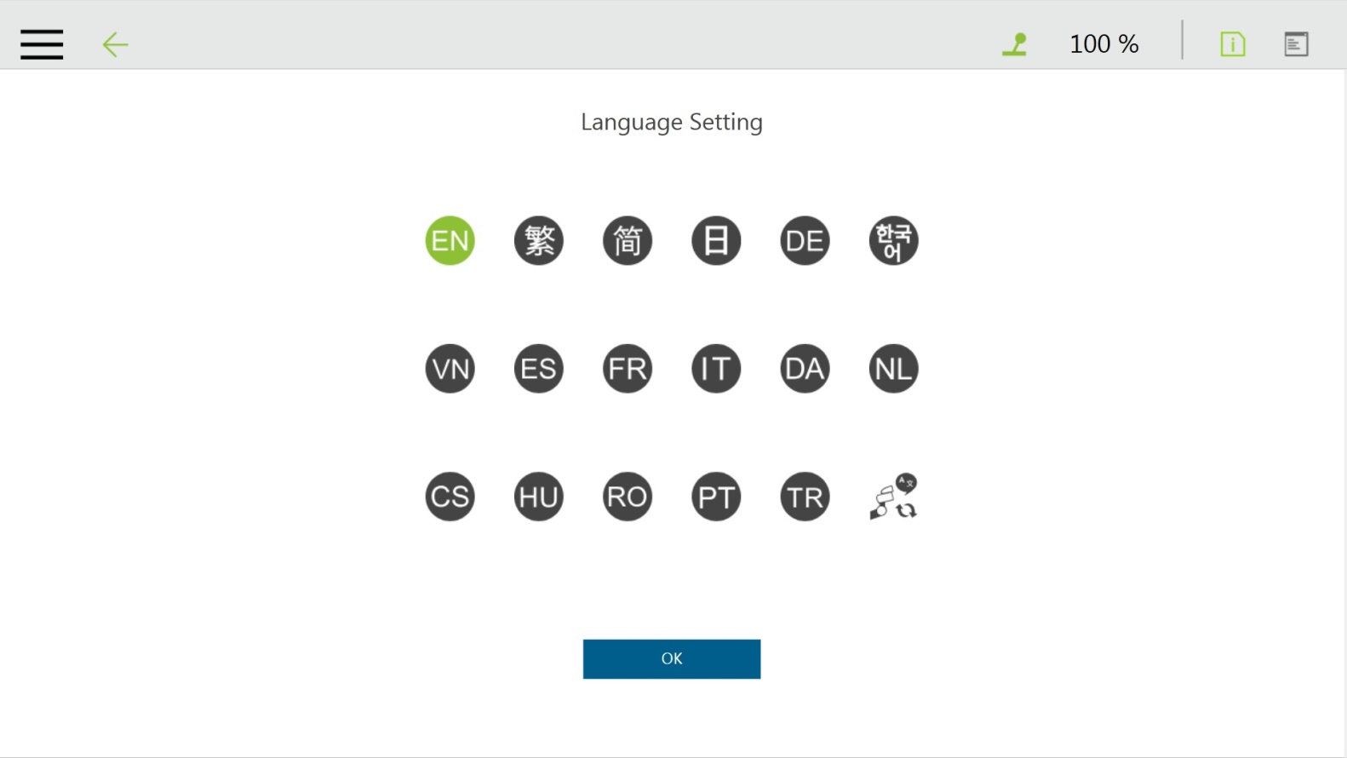
Function Operation

Slide 5
